Slide 1


Introduction to Git & GitHub: Version Control Made Simple
Welcome to the essential guide to Git and GitHub, the cornerstones of modern software development. This presentation will demystify version control, empowering you to manage your code effectively and collaborate seamlessly with others.

Slide 2

What is Git? The Foundation of Version Control
Git, created by Linus Torvalds in 2005, is a powerful distributed version control system (DVCS). Unlike older systems, Git allows every developer to have a complete history of the project on their local machine. This means you can track changes, revert to previous versions, and even work offline.
Tracks code changes efficiently, acting as a historical record of your project.
Works locally on your computer, ensuring speed and independence from a central server.
Facilitates team collaboration by managing contributions from multiple developers without conflicts.

Slide 3

What is GitHub? The Cloud for Your Code
GitHub is a leading cloud-based platform that hosts Git repositories. It extends Git's capabilities by providing a robust environment for team collaboration and project management, making it an indispensable tool for developers worldwide.
Hosts Git repositories online, making your code accessible from anywhere.
Enhances collaboration through features like pull requests for code review, issue tracking for bug management, and comprehensive project management tools.
Acquired by Microsoft in 2018, it remains the largest host of source code globally, connecting millions of developers.

Slide 4





Key Git Concepts You Need to Know
Understanding these fundamental concepts is crucial for navigating Git effectively and collaborating within a development environment.
Repository (Repo)
Commit
Branch
The core folder where Git tracks your project and its entire history.
A snapshot of your project at a specific point in time, encapsulating changes made.
Independent lines of development, allowing parallel versions for features or fixes.
Merge
Remote
The process of combining changes from one branch into another, integrating developments.
An online repository (e.g., GitHub) that serves as the central hub for your local repo.

Slide 5

Setting Up Git Locally: Your First Steps
Before you can start versioning your projects, you need to install and configure Git on your system. This one-time setup ensures your contributions are properly attributed.
git config --global user.name "Your Name"
git config --global user.email "you@example.com"
Install Git: Download the appropriate version for your operating system from git-scm.com.
Configure your identity: This tells Git who you are, linking your commits to your name and email.
Initialize a new repository: Start tracking a new project with git init in your project directory.
Clone an existing repository: Download a project from an online source with git clone [url].

Slide 6

Basic Git Workflow Commands
Mastering these fundamental commands will allow you to navigate through your project's version history and manage your changes effectively.
git status: Check Your Project's State
git add [file] or git add .: Stage Your Changes
Displays the current state of your working directory and staging area, showing modified, untracked, and staged files.
Moves changes from the working directory to the staging area, preparing them to be included in the next commit. Use . for all changes.
git commit -m "Message": Save Your Progress
git log: Review History
Shows the commit history, listing each commit with its author, date, and commit message.
Records the staged changes into the repository's history as a new commit, along with a descriptive message.

Slide 7
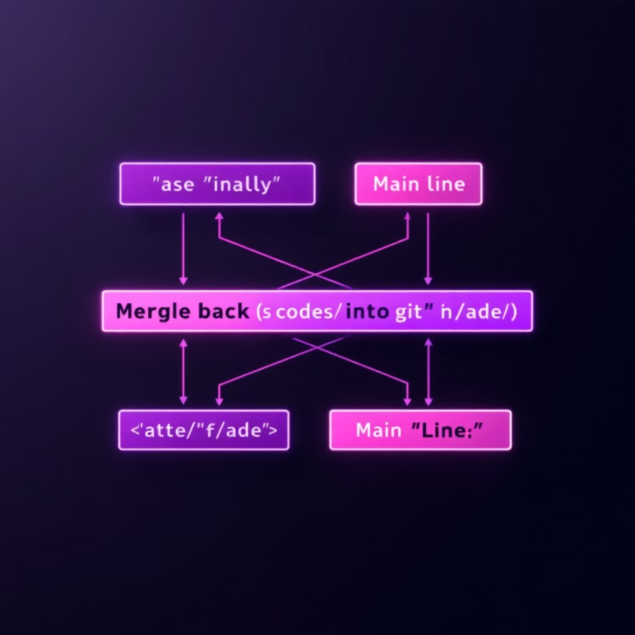
Working with Branches: Parallel Development
Branches are essential for isolating development work, allowing teams to work on multiple features or fixes concurrently without affecting the main codebase.
List branches: git branch shows all local branches.
Create a new branch: git branch [branch-name] creates a new branch, but you remain on the current one.
Switch branches: git checkout [branch-name] or the more modern git switch [branch-name] moves your working directory to another branch.
Create & switch instantly: git checkout -b [branch-name] creates a new branch and immediately switches to it.
Merge branches: git merge [branch-name] integrates changes from the specified branch into your current branch.

Slide 8


Syncing with GitHub: Remote Repositories
GitHub acts as your central hub, enabling collaboration and ensuring your project is backed up and accessible to your team.
1
Add Remote Repository
Connect your local repository to a remote one on GitHub using git remote add origin [url].
2
Push Changes to Remote
Upload your local commits to the remote repository with git push -u origin [branch]. The -u sets an upstream tracking branch.
3
Pull Updates from Remote
Download and integrate changes from the remote repository into your local branch using git pull.
4
Clone an Entire Repository
To start working on an existing project hosted on GitHub, use git clone [url] to download a full copy.

Slide 9

Handy Git Commands for Daily Use
These commands are invaluable for managing your codebase efficiently, troubleshooting, and maintaining a clean project history.
git diff
Shows differences between your working directory and the staging area (unstaged changes).
git reset [file] / git checkout -- [file]
reset unstages changes; checkout discards local modifications in your working directory.
git rm [file]
Removes a file from both your working directory and the staging area, preparing it for a commit.
git stash / git stash pop
stash temporarily saves uncommitted changes; pop reapplies them later.

Slide 10

Summary & Next Steps: Embrace Version Control
Git locally tracks your project history, providing robust version control.
GitHub hosts your repositories online, enabling seamless collaboration and project management.
Master core commands: init, add, commit, branch, merge, push, pull.
Practice with your own projects and explore GitHub features like pull requests and issue tracking.
Leverage resources like the Git Cheat Sheet and GitHub Docs for continued learning.
Start your version control journey today and collaborate like a pro!

